Slide 1
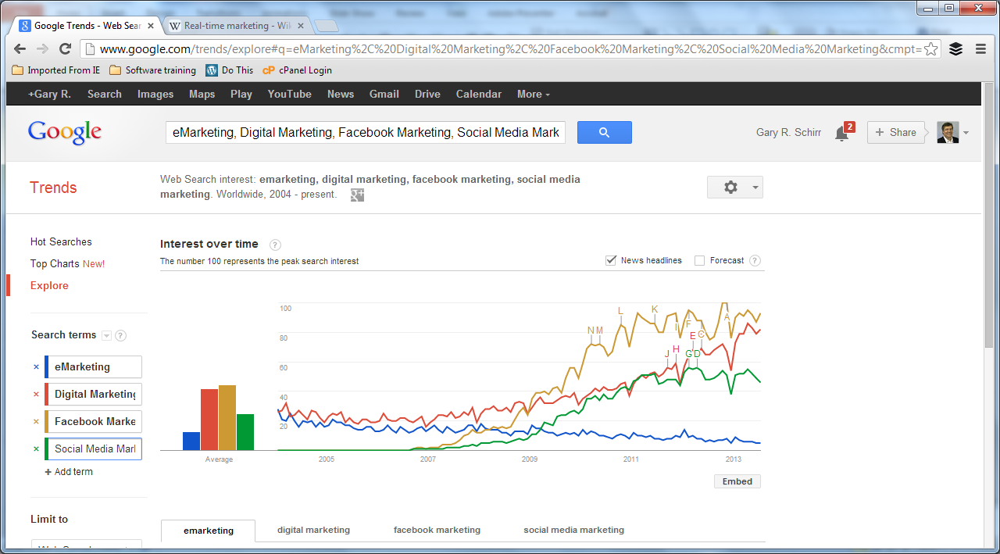
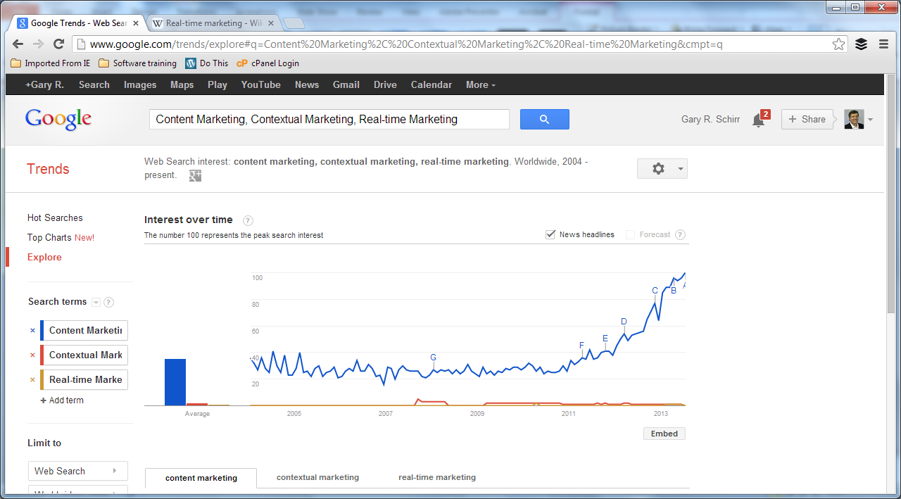
eMarketing and Digital-, Social Media- , FB- , Marketing
Content Marketing

